Slide 1
Personal Exemptions
Pub 17 – Chapter 3
Pub 4012 – Tab C
(1040-lines 6a & 42)
NJ 1040
Notes:
1

Slide 2
Exemption
Defined: Specific amount of money you are allowed to deduct from your taxable income, based on circumstances of your filing situation
Two types of Exemptions:
Personal Exemption
Dependent Exemption (to be covered in later section)
Enter all exemption-related data in TaxSlayer Basic Information section
Data is carried to Federal 1040 Page 1 and NJ 1040 Page 2

Slide 3
Summary of Personal Exemptions Types
Exemption Type | Federal Exemption | NJ Exemption
Personal exemption for Taxpayer & Spouse | Yes | Yes
Domestic Partner | No | Yes (only if partner doesn’t file own NJ1040)
Age over 65 | No (extra added to standard deduction) | Yes
Blind | No (extra added to standard deduction) | Yes
Disabled | No | Yes
Minor can claim self | No | Yes
Veteran exemption | No | Yes (New for 2017)
Note: An individual is not a qualifying child of a person if that person is not required
to file a tax return and doesn’t file or files only to claim a refund of paid taxes
* NEW RULING IN 2017; CAN BE APPLIED TO ANY OPEN TAX YEARS

Slide 4
Personal Exemption Rules – Taxpayer and Spouse
One exemption for taxpayer (and one for spouse if MFJ)
Widow(er) can file MFJ and claim 2 personal exemptions in year of death if:
not remarried by 12/31
not divorced or legally separated on date of death
Taxpayer filing MFS can claim spouse (“non-working spouse”) if:
spouse has no gross income
spouse not filing a return
spouse not the dependent of another taxpayer

Slide 5
NJ Exemption: Domestic Partner
NJ 1040 Page 3
Not recognized on Federal 1040
Additional NJ exemption ($1,000) for dependent Domestic Partner that does not file own return
Domestic Partner is different than Civil Union Partner filing status
Domestic Partner status requires affidavit and then registration
Same-sex and opposite-sex couples
Grants couples basic rights
i.e. - the right to make health care decisions and to receive tax exemptions
At least age 62 (after 2/2007). Younger couples if Domestic Partnership formed before revised law 2/2007

Slide 6
TS - Domestic Partner State section \ Edit \ Enter Myself \ NJ State Return \ Congratulations (enter YES) \ Basic Information
Question only appears if filing status is Single

Slide 7
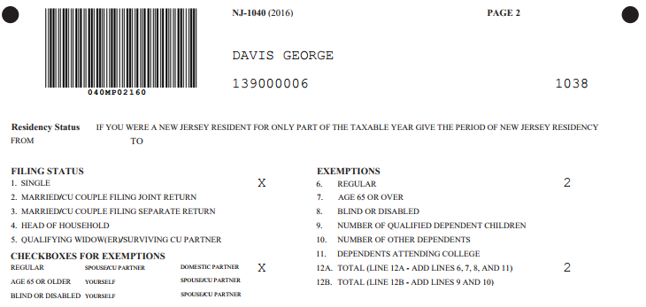
TS - NJ 1040 Page 2 - Domestic Partner
1 regular exemption for taxpayer;
1 for domestic partner

Slide 8
TS - No Extra Exemption For 65 or Over but Addition to Standard Deduction-Federal 1040
TS automatically adds extra to standard
deduction if 65 or older
Extra standard deduction
if 65 or over

Slide 9
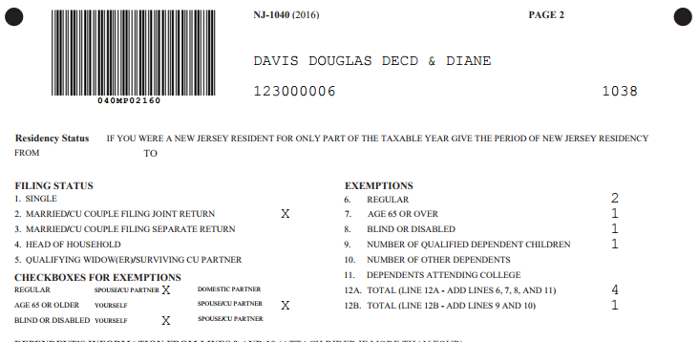
TS - Extra Personal Exemption For 65 or Over - NJ 1040
NJ grants extra personal exemption
if 65 or older

Slide 10
Who is Considered Blind for Federal and State Tax Purposes?
For Federal and State tax purposes a person is considered Blind if on the last day of the year they are totally blind or
A taxpayer who is not totally blind must have a certified statement from an eye doctor (ophthalmologist or optometrist) that:
The taxpayer cannot see better than 20/200 in the better eye with glasses or contact lenses, or
The field of vision is not more than 20 degrees
Additional standard deduction allowed on Federal 1040 for blind
Additional exemption allowed on NJ 1040 for blind

Slide 11
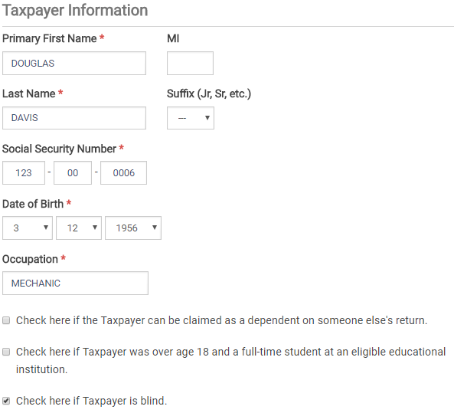
TS - Identification of Blind Basic Information section \ Personal Information

Slide 12
TS - Extra Standard Deduction for Blind Only, Not Disabled – Federal 1040
Federal only grants extra standard deduction
for blind, not disabled
Notes:
No extra standard deduction for disabled on Federal return (only blind)

Slide 13
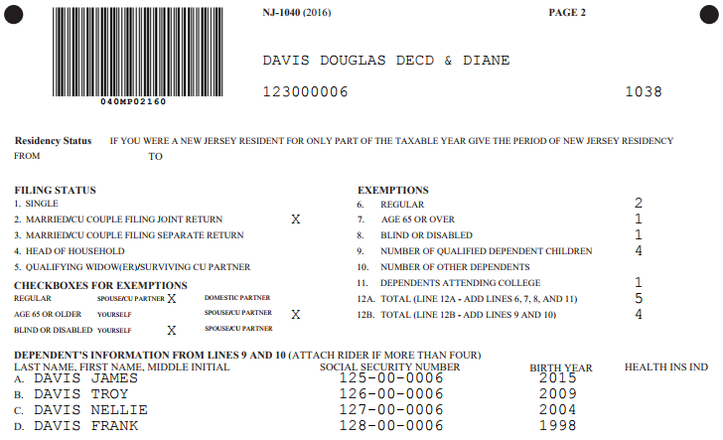
TS - Extra Exemption for Blind – NJ 1040
NJ grants extra exemption for blind OR disabled
Notes:
Can claim extra exemption for blind or disabled on NJ 1040 Line 8
Federal claims 6 exemptions
Taxpayer and spouse
4 children (including grandson)
Also gets extra standard deduction for taxpayer being over 65, but no extra for disabled
NJ claims 9 exemptions
Taxpayer & spouse
Both taxpayer & spouse over 65
Spouse is disabled
4 children (including grandson)
1 full-time college student

Slide 14
Who is Considered Disabled for Federal Tax Purposes?
For Federal tax purposes a person is considered disabled if at any time during the tax year he/she:
Could not engage in substantial gainful activity for pay or profit due to a physical or mental condition AND
A doctor has determined that this condition has lasted or can be expected to last continuously for at least a year or can be expected to lead to death
Additional standard deduction allowed on Federal 1040 for blind only (not other disabilities)
Disabled persons may be eligible for other Federal tax benefits like credits (covered in later modules)
Notes:
Anyone who is receiving SS disability (therefore recorded as disabled) by SS is by default considered disabled

Slide 15
Who is Considered Disabled for NJ Tax Purposes?
For NJ tax purposes: a person is considered disabled if on the last day of the tax year he/she:
Could not engage in substantial gainful activity for pay or profit due to physical or mental impairment, including blindness
Reporting: Must enclose a copy of the doctor’s certificate or other medical records with NJ tax return the first time the exemption is claimed

Slide 16
Who is Considered Disabled for NJ Tax Purposes?
(cont’d)
Additional exemption allowed on NJ 1040 for blind or disabled
Only one additional exemption allowed if both blind and disabled
Disabled/Blind persons may be eligible for other NJ tax benefits like property tax relief programs (covered in later module)
Note disabled status in NJ Checklist Basic Information section for later entry in the TaxSlayer State section

Slide 17
TS - Extra Exemption for Disabled – NJ 1040
NJ grants extra exemption for blind OR disabled
Notes:
Can claim extra exemption for blind or disabled on NJ 1040 Line 8
Federal claims 6 exemptions
Taxpayer and spouse
4 children (including grandson)
Also gets extra standard deduction for taxpayer being over 65, but no extra for disabled
NJ claims 9 exemptions
Taxpayer & spouse
Both taxpayer & spouse over 65
Spouse is disabled
4 children (including grandson)
1 full-time college student

Slide 18
TS - Extra Exemption for Disabled – NJ 1040
Only 1 extra exemption if both blind and disabled
Notes:
Can claim extra exemption for blind or disabled on NJ 1040 Line 8 (but only 1 extra if both blind and disabled)
Federal claims 7 exemptions
Taxpayer and spouse
5 children (including grandson)
Also gets extra standard deduction for taxpayer being over 65, but no extra for disabled
NJ claims 10 exemptions
Taxpayer & spouse
Taxpayer over 65
Spouse is disabled
5 children (including grandson)
1 full-time college students

Slide 19
Federal/State Differences: Exemptions for Minors Who Can Be Claimed on Parent’s Return
ITEM | FEDERAL | STATE | COUNSELOR ACTION
Minor/ Can be claimed on parents’ return (even if not claimed) | Minor cannot claim personal exemption for self | Minor can claim personal exemption for self | Click on Basic Information section \ Personal Information \ “Check here if the Taxpayer can be claimed as a dependent on someone else's return”
Note: An individual is not a qualifying child of a person if that person is not required to file a tax return and doesn’t file or files only to claim a refund of paid taxes
* NEW RULING IN 2017; CAN BE APPLIED TO ANY OPEN TAX YEARS

Slide 20
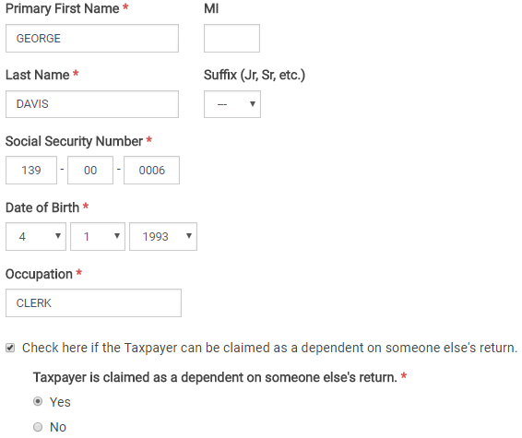
TS - Minor Claimed on Parent’s Return Basic section \ Personal Information (on Minor’s Return)

Slide 21
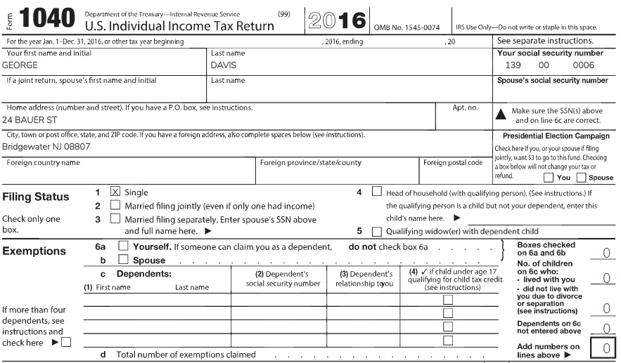
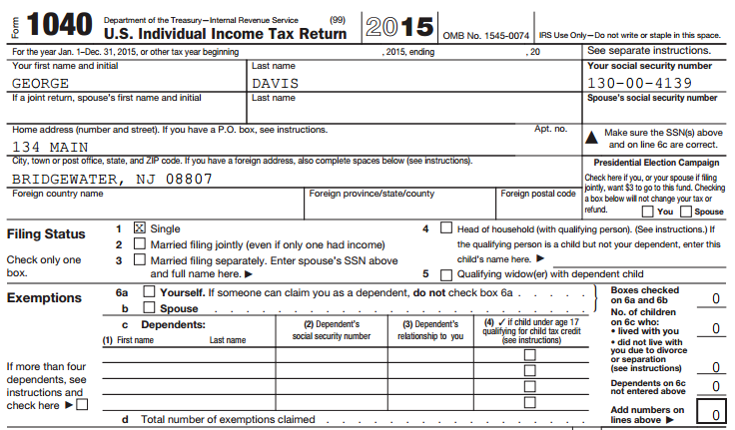
TS - Minor Claimed on Parent’s Return – Minor’s Federal 1040
Can’t take exemption for self since minor was claimed on parents’ Federal return
Notes:
Since minor can be claimed on parents’ Federal return, cannot claim exemption for self on minor’s Federal return

Slide 22
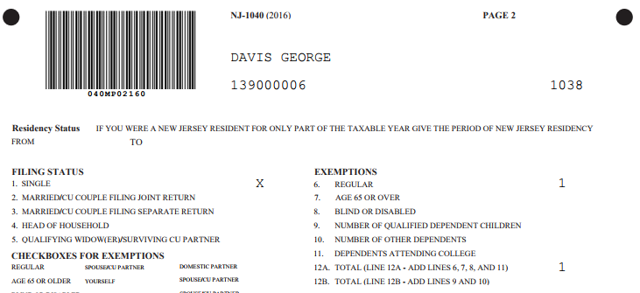
TS - Minor Claimed on Parent’s Return – Minor’s NJ 1040
On NJ 1040, OK to take exemption for self even when minor was claimed on parents’ Federal return
Notes:
Minor can still claim exemption for self on minor’s NJ return, even if parents claimed him
TaxSlayer does this automatically if you check the box that says you can be claimed on someone else’s return

Slide 23
NJ Veteran Exemption
New exemption for military veterans New for 2017
$3,000 per person (taxpayer and spouse can each claim if appropriate)
Must have been honorably discharged or released under honorable circumstances from active duty in the Armed Forces by last day of tax year
Cannot claim for domestic partner or dependents
Must provide a copy of DD-214 Certificate of Release or Discharge from Active Duty the first time you claim exemption
Can send in DD-214 prior to or with income tax return to certify eligibility
Info on requesting a copy of DD-214 can be obtained on www.archives.gov
Notes:
23

Slide 24
Filing a Return for a Deceased Taxpayer
Pub 4012 Tab K
Deceased taxpayer will be identified as a checked box on Intake/Interview form Page 1, Part II - Widowed
Deceased Taxpayer’s return
Final personal income tax return must be filed
Estate tax return (Form 1041) may need to be filed Out of Scope
Personal tax return can be filed by:
Surviving spouse
Personal representative – Executor of estate or anyone who is in charge of decedent’s property
Court appointed representative
Notes:
24

Slide 25
Filing a Return for a Deceased Taxpayer
Pub 559
(cont’d)
Return filed by surviving spouse
Should include income earned by decedent up to date of death plus full-year income for surviving spouse
TaxSlayer will print “Filing as surviving spouse” as deceased taxpayer signature on Form 8879
Return filed by personal representative (executor or administrator of the decedent’s estate, as appointed or certified by the court)
Only include income & deductions up to date of death
File Form 56 Notice Concerning Fiduciary Relationship to notify IRS of contact for correspondence
If filing a current year tax return and refund is due, attach copy of Court Appointment Certificate
Sign return followed by “Personal Representative”
Notes:
25

Slide 26
Filing a Return for a Deceased Taxpayer
Pub 559
(cont’d)
Return filed by anyone else
If refund is due, include Form 1310 Statement of Person Claiming Refund Due a Deceased Taxpayer
Form 1310 can be found in Federal section \ Miscellaneous Forms
For NJ return, if refund is due and you want NJ Division of Taxation to issue check to surviving spouse or estate, paper file return and include death certificate
Refer to Pub 4012 Page K-12 for more detail
Notes:
26

Slide 27
TS - Printed 1040 Return Of Deceased Taxpayer
TaxSlayer populates on printed 1040
Deceased notice will not appear on TaxSlayer 1040 screen under Summary/Print, only on printed return PDF
Notes:
TaxSlayer will populate “Deceased” & date of death on name line of printed 1040 page 1
Will not appear on TaxSlayer 1040 screen
27

